Slide 1
Course Introduction
CIS 300: Computer Information Systems
Professor Matt Thatcher

Slide 2
Start Tegrity!

Slide 3
Today’s Agenda
Course Administration
  Course website (Blackboard)
    https://blackboard.louisville.edu/webapps/login
  Syllabus and Schedule
    BB > Course Information (where BB = Blackboard)
  Software tools (MS Office 2007)
    MS Excel and MS Access
  Homework Assignments, Projects, and Labs
    BB > Assignments
  Tests (4)
Course Introduction
  Business Information Systems (IS): An Overview

Slide 4
Course Administration

Slide 5
Who am I?
Dr. Matt Thatcher
  Associate Professor in Computer Information Systems (CIS)
  Please call me either: Dr. Thatcher, Professor Thatcher, or Matt
Education
  The Wharton School, University of Pennsylvania
    Ph.D. (Information Systems and Economics)
    M.S. (Information Systems)
    B.S. (Finance and Decision Sciences)
Previously, I was a CIS Professor at
  University of Nevada, Las Vegas (2006 – 2008)
  University of Arizona (1997 – 2006)
Raised in Lexington, KY

Slide 6
CIS 300 Sections
Section | Days and Times | Instructor
01 | MW 9:30am - 10:45am | Thatcher
02 | MW 11:00am - 12:15pm | Dos Santos
03 | MW 1:00pm - 2:15pm | Kunene
04 | TTh 9:30am - 10:45am | Chandra
05 | TTh 11:00am - 12:15pm | Chandra
06 | TTh 1:00pm - 2:15pm | Barker
08 | TTh 4:00pm - 5:15pm | Chandra
77 | W 5:30pm – 8:15pm | Zurada

Slide 7
Course Resources
Course information (very important!)
  https://blackboard.louisville.edu/webapps/login
  We meet MW 9:30 am – 10:45 am in BS 003
My contact information
  Email: matt.thatcher@louisville.edu
  Office phone: (502) 852-4780
  Office: CoB Room 304
Office Hours
  MW 12:30pm – 1:30pm, or by appointment (just email me)
Free computer tutoring is available through REACH
  http://www.reach.louisville.edu/tutoring/computer
  Location: Computer Resource Center, Ekstrom Library 1st Floor
  Phone: (502) 852-7569
  MS Excel, MS Access, and other Office tools

Slide 8
Goals of the Course
Information systems (IS) enable business
Introduce you to many concepts of IS
  You will become familiar with the functions of computer-based IS
  You will develop an advanced understanding and competency of spreadsheet (MS Excel) and database (MS Access) software tools that you will use both as a business student and later as a business professional
  You will be exposed to concepts and tools that enhance your ability to define, analyze, and solve various business problems
  You will form critical opinions about the use of IS in the world
  You will learn about IS-related security risks at the individual and business levels and how individuals and companies deal with these threats

Slide 9
Class Structure
Registration
  Everyone registered?
  If not, please visit Undergraduate Advising immediately
  What about the waitlist?
Syllabus
  Read carefully!
  BB > Course Information > Syllabus
Schedule
  Skim to get an idea of (1) what we will be doing, (2) when tests will be administered, and (3) when assignments/projects will be due
  BB > Course Information > Schedule
Class slide presentations (including today’s)
  BB > Course Documents > Class Slides

Slide 10
Prerequisites
Students should have previously taken:
  CIS100 – Introduction to Microcomputer Applications (or comparable course)
  Transfer students should seek out their Advisor if they are not certain about this prerequisite
Working knowledge of
  Blackboard
  Email (plan to use your GroupWise email listed in BB)
Basic understanding of
  MS Excel, MS Word, MS PowerPoint, and the Web

Slide 11
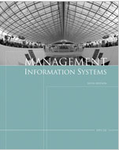
Required Textbook
Management Information Systems, 6^{th Edition}, by Effy Oz
  Make sure it is the 6th Edition
  Course Technology © 2009
  ISBN: 1423901789
  Textbook Web site
Purchase at
  UofL Bookstores
  On-line retailers (may be cheaper)
    Amazon.com (MIS by Effy Oz)

Slide 12

Highly Recommended
Excel 2007 Bible by John Walkenbach
  Wiley © 2007 (ISBN: 0470044039)
  Amazon.com (Excel 2007 Bible)
  Runs about $30 (worth it)

Slide 13

Highly Recommended
Access 2007 Bible by Michael R. Groh et al.
  Wiley © 2007 (ISBN: 0470046732)
  Amazon.com (Access 2007 Bible)
  Runs about $30 (worth it)

Slide 14
Required Technology
Technology resources you need this week
  Access to Blackboard
    https://blackboard.louisville.edu/webapps/login
  Access to the Internet
    Internet Explorer 7.0 (preferred) or Mozilla Firefox 3.0
  Access to MS Office 2007 applications
    MS Excel, MS Access, MS Word, MS PowerPoint
  USB Thumb/Flash Drive (at least 4GB)
    Very important for storing and transporting course files
    About $12 - $15 at Walmart or Best Buy
  Access to Adobe Reader – available free
    BB > Course Information > Downloads (Plug-Ins and Free Software)
  Audio/Visual software – available free
    BB > Course Information > Downloads (Plug-Ins and Free Software)

Slide 15
Class Schedule
Begins Jan 11 and runs through Apr 21
  No class for this Section of CIS 300 on:
    Wed, Jan 6 (I was out of town)
    Mon, Jan 18 (Martin Luther King Day)
    Mon, Mar 15 (Spring Break)
    Wed, Mar 17 (Spring Break)
See Course Schedule for:
  Class Meeting Dates, Times, Location
  Due Dates for Homework Assignments and Projects
  Test Dates
  Final Exam Date and Time
    Section 01: Friday, April 23 (8:00 am - 10:30 am)

Slide 16
Teaching Style
Lectures
In-class discussions
Computer lab exercises
  See Schedule for lab days → 304 Davidson Hall Lab
Case study examples

Slide 17
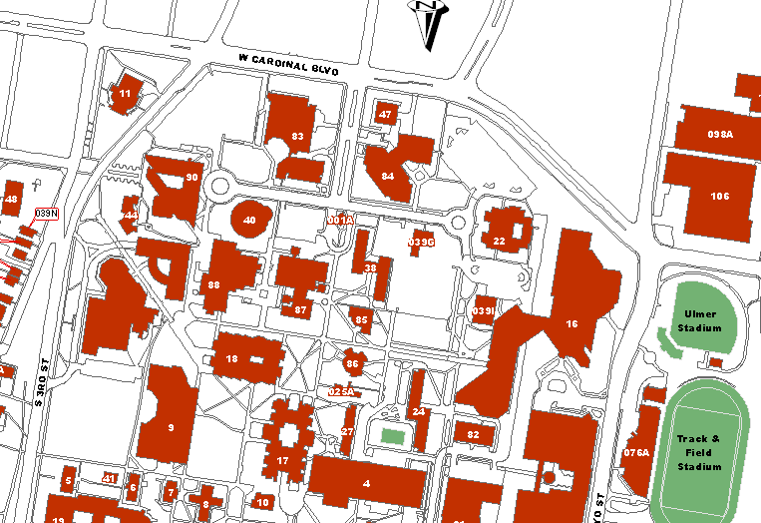
College of Business
Davidson Hall

Slide 18
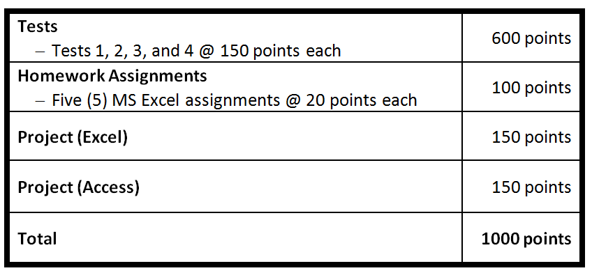
Grading Basis
Assessments
Demanding workload
  5-10 hours a week in addition to class meetings

Slide 19
Initial Assignment (Extra Credit)
Extra credit opportunities will be limited
First opportunity is to complete the following activity:
  Lab 1: Student Information Survey (4 points)
    BB > Tests (complete it online in BB)
    Due: Fri, Jan 15 by 9:00pm
  I strongly urge you to complete this activity!!
  This activity is listed in the course Schedule

Slide 20
Homework Assignments
(Complete Individually or in Teams of 2 Students – No Cross-Section Teams)
Read the Homework Instructions
  BB > Assignments > Homework > Homework Instructions
MS Excel Assignments
  HW 1 (20 points)
    Basic Excel Features (IF, Nested IFs, Boolean Logic, and basic functions - MIN, MAX, SUM, AVERAGE, COUNT)
  HW 2 (20 points)
    Basic Excel Features (IF, Nested IFs, Boolean Logic, and basic functions - MIN, MAX, SUM, AVERAGE, COUNT)
  HW 3 (20 points)
    More Advanced Excel Features (COUNTIF, SUMIF, VLOOKUP, HLOOKUP, LOOKUP, ISNA, LARGE, SMALL)
  HW 4 (20 points)
    More Advanced Excel Features (Text Manipulation and Date Functions)
  HW 5 (20 points)
    More Advances Excel Features (INDEX, MATCH, VLOOKUP)

Slide 21
Projects
(Complete Individually or in Teams of 2 Students – No Cross-Section Teams)
Project (MS Access)
  Developing a Database Management System for a business
  MS Access (Tables, Queries, Reports, Forms, Custom Navigation Panes, Importing Data)
  Details to be discussed in class
Project (MS Excel)
  Developing a Decision Support System (DSS) for business decision-making
  What-If Analysis
  Due as the Final Exam for this course
  Details to be discussed in class

Slide 22
Assignment Turn-In
All Assignments are due by the due date/time specified in the schedule via Blackboard for grading
  Turn in via: BB > Assignments > Submit Work Here
Assignments will not be accepted late unless the professor has approved it in advance

Slide 23
Labs
(Supplemental)
Lab | Name | Type
1 | Student Information Survey | Extra Credit
2 | College Admissions | Excel
3 | Payroll Calculations | Excel
4 | Loan Applications | Excel
Completing these labs will help prepare students for Tests, Projects, and the business world

Slide 24
Tests
Total of four (4) Tests
  Closed book and closed notes
  Taken in-class, hard copy tests
  Covers lecture material, Homework Assignments, textbook readings, labs, and related material in Blackboard
  Multiple-choice, true/false, and brief essay questions taken largely from the textbook and in-class discussions
  Fill-in-the-blank questions that will evaluate your knowledge, critical thinking, and problem-solving skills with respect to MS Excel
Each Test is worth 150 points
Final Exam date [in-class work on Project (Excel)]
  Section 01: Friday, April 23 (8:00 am - 10:30 am)

Slide 25
Tests
Regarding missed exams
  Do not do it!
  See the policy in BB > Course Information > Syllabus

Slide 26
Top 10 Ways to Earn a Good Grade
Read assigned material prior to class
Attend all class meetings and participate fully in class
Ask questions and raise concerns about the course during class and office hours
Do not copy the work of others
Work through all Labs, Homework Assignments, and Sample Tests to ensure that you can solve the exercises

Slide 27
Top 10 Ways to Earn a Good Grade
Begin Assignments and Labs early – do not procrastinate until the last minute
Compare your assignment results to solution sets posted to Blackboard
Review Test feedback to determine where you need to improve your skills
Seek assistance when you need it
Work hard and have fun!

Slide 28
Responsibilities
Me
  Make sure you understand
  Keep you amused and interested in coming to class
  Make this class useful to you for succeeding at University of Louisville and getting and keeping a job
You
  Engage in the top ten ways to earn a good grade!
  Do the readings
  Come to class ready to participate
  Find help when you need it
  Tell me if I am going too fast/slow

Slide 29
Tutoring - REACH
Free tutoring for this course is available to undergraduate students through REACH
  Location: Computer Resource Center, Ekstrom Library 1st Floor
  Phone: (502) 852-7569
  http://www.reach.louisville.edu/tutoring/computer
  http://www.reach.louisville.edu/tutoring/general/request.html
  MS Excel, MS Access, and other Office tools
Take the initiative to seek out additional assistance if you believe you need it

Slide 30

Just a Few Rules
Food and drinks not permitted in classroom
  Except a bottle of water
Silence cellular phones and pagers
PCs are for educational use only
Be prepared - read material in advance
Be prompt - arrive to class on time
Get work done ahead of schedule
Plagiarism will not be tolerated

Slide 31
Email Guidelines
Things you should do:
  Be sure to include CIS 300 and your section on your subject line
  Use meaningful subject lines – Important!
    For example – “Assignment 1 Question”
  Identify yourself (first and last name) at the end of the message
  Be sure to include relevant portions of prior messages
    I receive many emails per day. Receiving a follow-up email without any context may prevent me from understanding or answering your questions
  If you use “reply” to send an unrelated follow-up message, make sure that you revise the subject line to be descriptive of the new topic.
  Do not include attachments unless requested
    Unless requested, attachments will be considered as possible viruses

Slide 32
Any Questions So Far?

Slide 33
Reminders
Use Blackboard!!!
  https://blackboard.louisville.edu/webapps/login
Important elements of Blackboard include
  BB > Course Information
    Syllabus, schedule, BB grading symbols, plug-ins and free software, and other useful information
  BB > Course Documents
    Class Slides: contains my PowerPoint presentations
    Excel: links to useful tutorials and materials
    Access: links to useful tutorials and materials
  BB > Assignments
    Labs, Homework Assignments, Projects, Submit Work Here
  BB > Announcements
    Check the course Announcements often

Slide 34
Blackboard
Let’s take a tour!!!
  https://blackboard.louisville.edu/webapps/login
Scheduled downtimes (EST):
  Thursdays 3:30am - 4:00am
  Fridays 10:00pm - 2:00am
  Sundays 1:30am - 5:30am
  Technical issues are not an acceptable excuse for late assignments

Slide 35
Blackboard
Tegrity Classes
  I will use this technology for my sections of CIS 300
What is Tegrity?
  Captures lectures (and presentations from the computer monitor) and provides them via Blackboard to students
  Students can quickly recall key segments of classes or replay entire classes online
Getting access to class captures online
  BB > Tegrity Classes
  It’s easy to use
  Lectures will often be uploaded within a few hours of the conclusion of class
Let’s take a tour!
  Required: View BB > Tegrity Classes > MS Excel 2007 Overview

Slide 36
CIS Content Overview
(See the Schedule)
Introduction to IS
  Defining an Information System (IS)
  Types of organizational IS
  Collaborative IS
Organizing and Storing Information
  Strategic Uses of IS
  Searching and Organizing Information on the Internet
  Databases and Data Warehouses (MS Access and MS Excel)
Analyzing Information
  Decision Support Systems and Expert Systems (MS Excel)
Communicating Information
  Human-Computer Interaction (MS Access and MS Excel)
  Business Networks and Telecommunications
Securing your IS
  Risk, Security, and Disaster Recovery

Slide 37
MS Excel 2007 Content Overview
(Homework Assignments 1 - 5 and a Project)
Excel 2007 Basics (ribbon, navigation, cell referencing, formulas)
  Required: View BB > Tegrity Classes > MS Excel 2007 Overview
Basic Excel functions
  SUM, MIN, MAX, AVERAGE, COUNT, COUNTA, ROUND
  IF Statements, Nested IF Statements
  Boolean Logic Functions (AND, OR, NOT)
Advanced Excel Functions
  COUNTIF, SUMIF, AVERAGEIF
  LARGE, SMALL
  VLOOKUP, HLOOKUP, LOOKUP
  IS Functions (ISNA, ISERROR, ISNUMBER, ISTEXT, ISBLANK)
  Text Manipulation Functions (LEFT, RIGHT, FIND, LEN, CONCATENATE, &, PROPER, UPPER, LOWER)
  Date and Time Functions (TODAY, YEARFRAC, DATEDIF)
  Database features/functions (Tables, Filtering, Sorting, DSUM, DMAX, DMIN, DCOUNT, DCOUNTA)
  Analysis Tools (One-Way and Two-Way Tables, Scenario Manager, Goal Seek, Solver)
  INDEX, MATCH

Slide 38
MS Access 2007 Content Overview
(Project)
We will walk through creating and modifying:
  Tables
  Queries
  Reports
  Forms
  Custom Navigation Panes
Importing/exporting external data

Slide 39
Business Information Systems:
An Overview

Slide 40
The Purpose of IS
Help people solve problems and make decisions
  Requires information
Keys to success in business are:
  Input (collect and organize relevant data)
    Transaction (the foundation of an organization) – a business event, usually entered as input
  Data processing (perform calculations on input)
  Output (producing information)
  Storage (vast amounts of data/information stored)

Slide 41
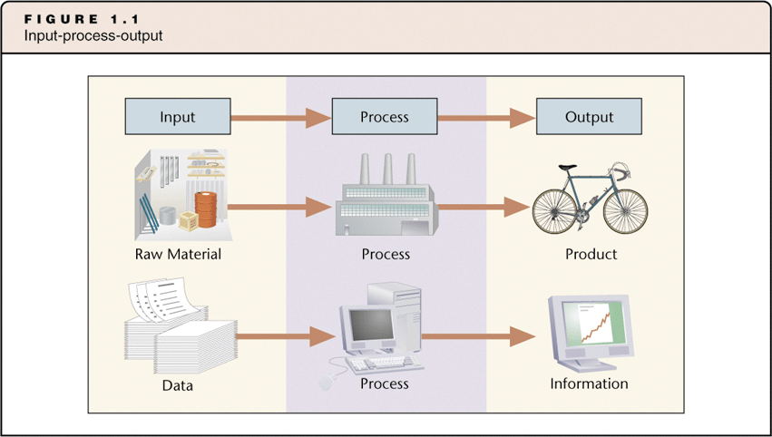
Generating Information

Slide 42
Generating Information
Data
  A given or fact
  Can be a number, statement, or picture
Process
  A manipulation of data
  Can be addition, multiplication
  Can be an algorithm that matches customers to products
Information
  Facts or conclusions that have meaning within context
Example
  What is the average age of students in this class?

Slide 43
Generating Information
(more examples)
What products will Matt Thatcher want to purchase from e-commerce sites?
(e.g., Amazon.com, Travelocity.com)
  Data?
  Process?
  Information?
  What decisions does Amazon.com make based on this information?

Slide 44
Generating Information
(more examples)
What about online dating sites?
(e.g., match.com, eharmony.com)
  Data? Process? Information? What decisions are made?
What about retail stores or grocery stores?
(e.g., Kroger’s, Smith’s, Walmart)
  Data? Process? Information? What decisions are made?
What about casinos?
(e.g., Caesar’s Palace, The Venetian)
  Data? Process? Information? What decisions are made?

Slide 45
What Is a System?
System
  Set of components that work together to achieve a goal or goals
  Accepts input, processes input, and produces output
A system may:
  Have multiple goals (think about an organization as a system)
  Contain subsystems (think about Finance, Accounting, Marketing, etc.)
Subsystems:
  Have sub-goals that meet the main goal
    What are the goals of Accounting? Finance? Marketing? Logistics?
  Transfer output to other subsystems
    How do these subsystems communicate and collaborate? IS automates much of this process!
  Think about an organizational system (next slide)

Slide 46
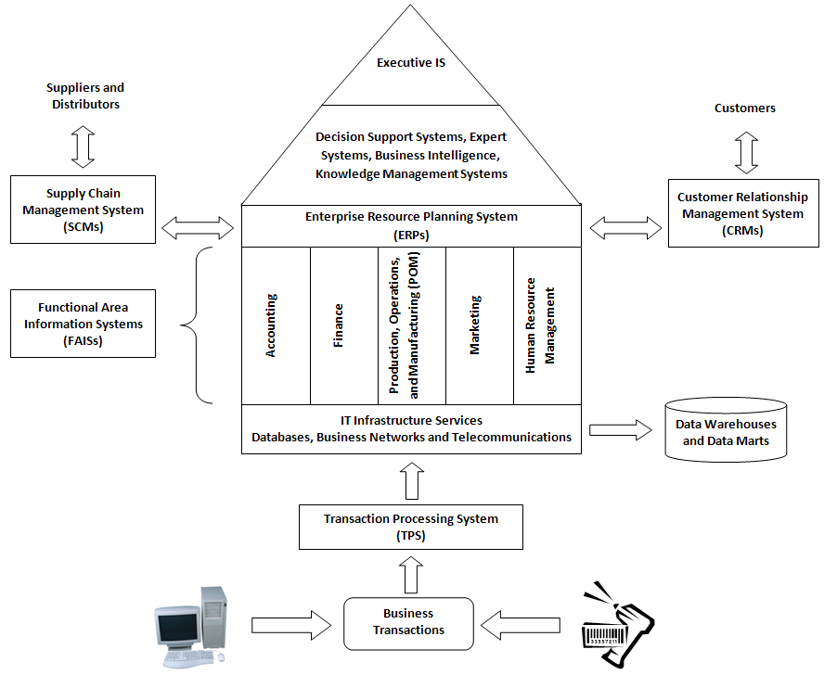
An Organization as a System with Subsystems

Slide 47
What is an Information System?
An Information System (IS) is group of components that interact to produce information
  Collects and organizes data
  Processes/analyzes the data
  Produces information (for problem-solving and decision-making)
Five fundamental components of IS
  Hardware
  Software
  Data (and Telecommunications)
  Procedures
  People

Slide 48
Information Technology (IT)
Raw technology
Focuses on 3 of the 5 components of IS
  Hardware
  Software
  Data (and Telecommunications)

Slide 49
How Does IT Differ from IS?
IT alone will not help an organization achieve goals
IT must be embedded into an IS to help accomplish objectives
  Technology must be combined with people and procedure components
  IS will make IT useful
    Information technologies are just tools – people need to use those tools in ways that create value

Slide 50
Examples of Common IS
We will discuss these in more detail
  Transaction process systems (TPS)
    Cash registers, ATMs, slot machines, online shopping carts
  Functional Area Information Systems (FAIS)
    Provide information to lower-level and middle-level managers in functional areas (e.g., Accounting, Finance, Marketing, HR, POM)
  Customer Relationship Management Systems (CRM)
    Phone support, online support, FAQs pages, online check-in for airline passengers, tracking systems (e.g., FedEx packages, travel reservations)
  Enterprise Resource Planning Systems (ERP)
    Tie together the different functional areas
  Supply Chain Management Systems (SCM)
    Link a company to its suppliers, distributors, and customers

Slide 51
New Opportunities
Moore’s Law
  Price/performance ratio of computers has fallen dramatically
    Computers are smaller
    Computers are less expensive
    It is the reason why the IS on the previous slide are so common!
  Drives the new IS opportunities!!
Free data storage, data communication, and free data transmission
  Education
    On-line courses (University of Phoenix)
    On-line course support (Blackboard, Tegrity)
  On-line traffic school
    Unfortunately, I am familiar with this
  Social Networks (YouTube, Facebook, MySpace)
    Cheap, powerful technology now enables an unprecedented level of connectivity among people

Slide 52
Summary
Computers and IS are everywhere
  They help people solve problems and make decisions
Some questions you should be able to answer
  What is a system?
  What is an information system (IS)?
  What is the purpose of an IS?
  What are the five components of an IS?
  How does IS differ from IT?
  What are examples of some common IS?
  What new opportunities for IS are developing today and what is driving these new opportunities?

Slide 53
Next Time
MS Excel Functions
  Required before next class: View BB > Tegrity Classes > MS Excel 2007 Overview (there may be a short quiz at the beginning of next class)
Reminders
  Read through BB materials!!
  View BB > Tegrity Classes > MS Excel 2007 Overview
  Play with BB > Tegrity Classes after this class has uploaded
  Complete the Student Information Survey
    BB > Tests (complete it online in Blackboard)
    Due: Fri, Jan 15 by 9:00pm
  Form teams of 2 to complete the course Homework Assignments and Projects

Slide 54

Say Cheese…

Slide 55
Stop Tegrity!

